Slide 1
Taxonomy Design

Slide 2
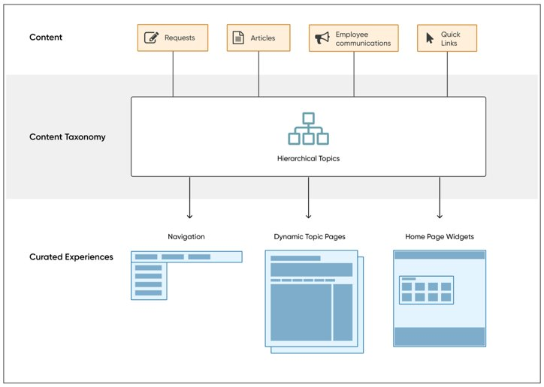
Employee Center Unified Taxonomy drives the experience
Employee Center Unified Taxonomy is the hierarchical categorization of all the content within the EC.
Contains topics which can be related to other topics in a Parent-Child relationship to form a hierarchy.
Topics are displayed through the Mega Menu, which stays with the user wherever they go in the portal.
All active content (catalog item/request, knowledge article, quick link, employee communication) should fit under a topic.
Topics can be hidden for certain user using user criteria.

Slide 3
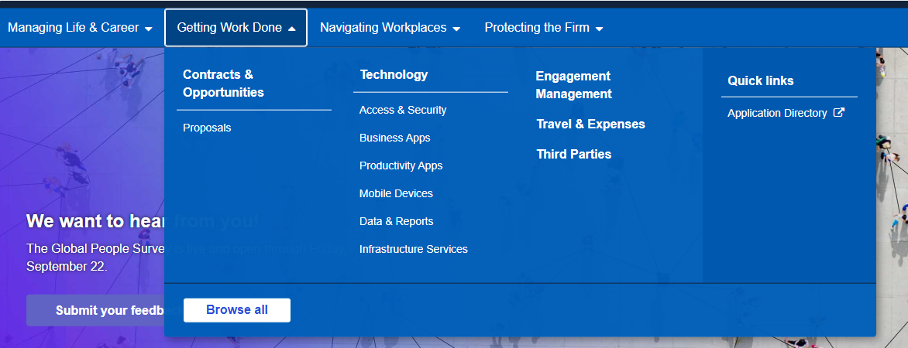
Unified Taxonomy comes to life through Mega Menu
The Mega Menu brings all the content together and allows workers to easily navigate through different topics within HR and IT, taking them where they need to be without clicking through pages of information.
Topic (top-level)
HR
IT
Topic (child topic 1)
benefits
hardware
Topic (child topic 2)
health
computers
Topic | Quick Link
Container for multiple pieces of content | Link to individual pieces of content
Visibility is controlled by the “connected content” | Visibility is conditional and can be defined
Having too many levels down may impact the way topics are displayed in the drop-down | Only visible in the Mega Menu if they tied to the top-level topic, otherwise only show on the associated topics page
Clicking on a topic under Mega Menu will take user to the topic page that has its “connected content” | Can link to catalog items and knowledge articles within ServiceNow or external pages (e.g., Workday, Degreed, etc.)
Best practices
Keep the number of top-level topics to 8-10
Nest topics 2-3 levels deep only
Consider consolidating child topic with less than 8 content items with another topic
Topic naming convention should be simple & user-centric
Categories and topics don’t have to be a 1:1 match
Not all content items need to be mapped to topics (will only show in Search)

Slide 4





IT Data to inform decision
Activity: Fill in the required data for the below topics. Use IT data to support.
Top Search Queries | Volume
SAP
Internet
USB
Security
ITSM
Sharepoint
App Support
Top Knowledge Articles | Volume
Virtual Workspace
Passwords
Desktop Support
SAP Support
Top Service Catalog Items | Volume
General IT Request
App Support Request
Internet Access Request
Password Reset
Most Viewed Pages | Volume
Service Catalog
Service Portal
Knowledge Base
Walk-up / Check-in
Contact Info
Search
Report Issue
Send as part of pre-workshop data request // workshop pre-read. Ask client to complete this slide with relevant IT data. Include client’s updated slide in the workshop presentation.

Slide 5
IT Current State
Keep | Data shows that employees use this topic regularly
Remove | Data shows employees do not use this topic regularly
TBD | More data is needed to make a decision
+ | indicates category contains other category(ies)
# | represents active/published items in that catalog/category and knowledge base
Activity: Add your current state IT service categories and knowledge categories
Current IT Service Categories
Current IT Knowledge Categories
Send as part of pre-workshop data request // workshop pre-read. Ask client to complete this slide with relevant IT data. Include client’s updated slide in the workshop presentation.

Slide 6
Taxonomy Exercise
Activity: Fill out the ideal future state mega menu structure based on the previous 2 data exercises
Topic: Information Technology
Topic: Human Resources
Child topic 1 | Child topic 2
Me
Benefits & Wellbeing
Recruiting, onboarding & offboarding
Career development | Transfer & mobility
 | Learning
Performance | Recognition
Child topic 1 | Child topic 2
Benefits | Leave of Absence
 | Medical
 | Dental
Notes:
HR service requests catalog (227)
Assignment & position (26) – Recruiting, onboarding & offboarding
Benefits (20) - Benefits
Continuous improvement (4) – Is this for everyone? Vendor & project management
Corp HR functional services (1) – can this mapped to any proposed topic?
Employee relations (9) - employee & labor relations
General inquiry (6) – doesn’t have to map to topic, can just show up in search or as quick link
Global mobility (11) – transfer & mobility
Labor relations (2) – employee & labor relations
Learning (16) – learning
Leaving Chevron (5) - Recruiting, onboarding & offboarding
Other HR services (0)
Pay (31) – pay & time off
Performance & career management (21) - performance
Recognition (3) - recognition
Reports, analytics, consulting & surveys (2) – Reporting & analytics
Services for the HR function (2) - Vendor & project management
Talent Management (0)
Time & leave (19) – benefits & wellbeing, pay & time off
Worker data (17)- me, worker data
(Empty) (33) - can these items mapped to any proposed topic?
IT
ABU catalog (14)
Application Support (5) – Software/Application
Applications (2) – Software/Application
Client Computing (1) - Hardware
Computer (1) - Hardware
Content Management (2) - Access
Mobile (2) - hardware
Productivity (1) - Collaboration
Support (5) - can these items mapped to any proposed topic?
Cloud Collection catalog (24)
(+) Cloud Services (0)
Legal Operations catalog (5)
General Legal Requests (1) – Legal
(+) Legal Requests (0) – Legal
TCO catalog (21)
Application Support (3) – Software/application
IT Service Management (1)
Operations (4)
Service Desk (1)
Support (3) - can these items mapped to any proposed topic?
IT Service catalog (832)
(+) Applications (26) – software/app
Business App Lifecycle Mgmt. (3) – software/app
Chevron Virtual Workspace (1) – access
(+) Client Computing (10) - hardware
(+) Communication & Collaboration (5) – collaboration
(+) Compute (5) – software/app
(+) Connectivity (7) – access
(+) Data (12) - data
(+) Data Center (4) – data center
Development (4) – software/app
(+) Emerging (0)
(+) Network (10) - infrastructure
(+) Operations (18) access, software/app
SAP S4 (2) – software/app
Security (6) – infrastructure
(+) Security & Compliance (21) – may need to split up
ServiceNow Platform Administration (4) – software/app, access
(+) Storage (1) ?
(+) Strategy & Planning (0)
(+) Support (300) – may need to split up

Slide 7
Connected Content & Roles

Slide 8
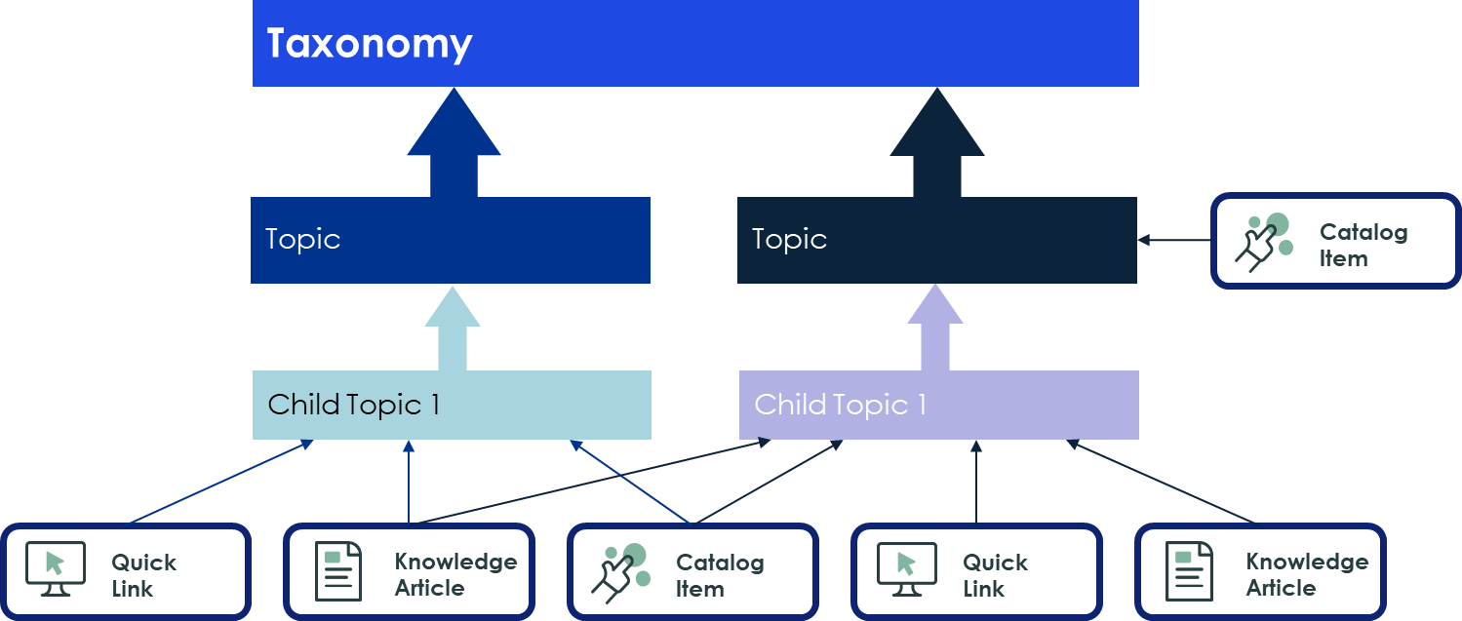
Connecting content to Topics
Connecting content such as service catalog items and knowledge articles to taxonomy topics will allow users to navigate and find content quicker while on the unified portal.
Service catalog items, knowledge articles, quick links, published content are considered content within Employee Center
Each content available to user should be mapped to a topic/child topic
Content not mapped to a topic will show when user searches
Individual content can be mapped at the topic or child topic level
One content can be mapped to multiple topics if needed
SFHSA can begin mapping content available for user once the topics and child topics are confirmed with KPMG for development.

Slide 9







Employee Center Taxonomy Roles
These are the roles associated with EC Unified Taxonomy, Content & Topics:
Employee Center Admin | Can manage and configure the Employee Center; has Taxonomy Admin privileges.
Taxonomy Admin | Can update and modify any created taxonomy in the taxonomy and topic tables. Can add/edit Taxonomy Manager and Contributor.
Taxonomy Manager | Can view any created taxonomy, update topics and associate content to topics. Can assign Taxonomy Contributors.
Taxonomy Contributor | Can associate content items to topics.
Content Manager | Can access all Content Publishing content, including content for which they are not in the audience.
Topic Manager | Can create, move, or clone topics within or between taxonomies, depending on the rights assigned to them.
Topic Contributor | Can manage topic level tasks, such as handling connected content, features content, articles, adding applications, and so on.
SF HAS will need to provide who in the organization will assume these roles to allow the management of taxonomy, topics and content on the EC Portal.

